Slide 1

The effect of fruit and vegetable interventions on micronutrient status among women of reproductive age: a systematic review
Sarah Kehoe^{1*}, Elena Rayner¹, Barrie M Margetts², Caroline HD Fall¹
¹MRC Lifecourse Epidemiology Unit, University of Southampton, UK; ²Public Health Nutrition, University of Southampton, UK
*sk@mrc.soton.ac.uk
Notes:
Good Afternoon everybody – I’d like to thank the organisers for this opportunity to tell you about a systematic review my co-authors and I designed and conducted as part of my PhD thesis.
We asked the question ‘What effect do fruit and vegetable interventions have on the micronutrient status of women of reproductive age’

Slide 2
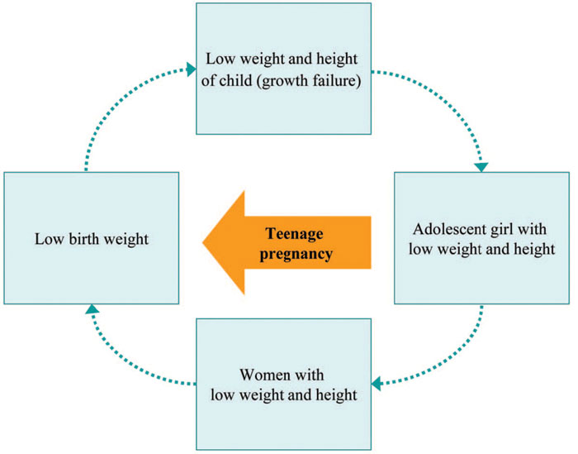
Background 1
Approximately 2 billion people globally are micronutrient deficient with women of reproductive age disproportionately affected. (Black et al, Lancet 2008;371:243-60 & Ramakrishnan, Nutr Rev 2002;60:S46-S52)
Notes:
The reason we asked this question is that micronutrient deficiencies are highly prevalent globally and disproportionately affect young women. This is detrimental to the women themselves and also to the next generation. Women who are undernourished tend to have babies with intra-uterine growth retardation who are less likely to achieve their genetic potential in terms of growth and development. In adulthood they are likely to give birth to small babies themselves and continue the cycle shown here.

Slide 3
Background 2
Diets in low and middle income countries are often cereal-based with low fruit and vegetable intakes. (Shetty in: Combating Micronutrient Deficiencies: Food-based Approaches, 2011:28-40).
At the International Conference on Nutrition in Rome (1992) it was declared that sustainable food-based strategies should be given priority in deficient populations.
Notes:
It has been suggested that these deficiencies are at least in part due to monotonous cereal based diets low in fruit, vegetables and other micronutrient rich foods. We chose to look at fruit and vegetables because they are acceptable to most populations, they can be sustainably produced and can be made affordable and accessible.
Furthermore, it was declared at the International Conference on Nutrition in 1992 that food based strategies should be given priority in deficient populations but there is little evidence on what is effective in this regard.

Slide 4

Objective
To determine whether fruit and vegetable interventions increased blood micronutrient concentrations or reduced prevalence
of deficiency among
women aged <40y .
Notes:
Our objective was to determine whether interventions aimed at increasing women’s consumption of fruit and vegetables lead to increased blood micronutrient concentrations or reduced prevalence of deficiency.

Slide 5
Method 1
Preferred Reporting Items for Systematic Reviews and Meta-Analyses (PRISMA) guidelines were followed.
MEDLINE, EMBASE, AMED and WHO Global Health Library Databases (http://www.who.int/ghl/directory/en/).
Notes:
We followed the PRISMA guidelines when designing and conducting the systematic review.
We searched MEDLINE, EMBASE, AMED and World Health Organisation Global Health Library Databases.

Slide 6
Method 2
Search terms: ‘fruit’ OR ‘vegetable’ OR [all edible plant taxonomic names and synonyms available on the USDA Germplasm Resources Information Network (GRIN) database (n=3623) (http://www.ars-grin.gov/cgi-bin/npgs/html/index)]. Combined with the MEDLINE Medical Subject Headings term ‘intervention study’ and text word searches for ‘intervention’ and ‘trial’.
Limited to humans and studies published in English.
Bibliographies of all included papers were used to identify additional relevant reports.
Notes:
We wanted to ensure that we captured all fruit and vegetables within our search terms so we used the United States Department of Agriculture Germplasm Resources Information Network database which contains all known edible plant names and synonyms. We combined this with a search for intervention studies.
We limited the search to humans and studies published in English.
We checked bibliographies of all included papers in order to identify additional relevant reports

Slide 7
Method 3 – Inclusion criteria
Intervention involving fruit and / or vegetables.
≥1 outcome(s): prevalence of micronutrient deficiencies; blood micronutrient concentrations.
Mean age of participants <40 years.
>50% of participants were female.
Notes:
The criteria for inclusion in the review were as follows: Interventions that involved fruit and / or vegetables. This could be supplying the participant with the food, giving them the means to obtain food (for example tokens), giving advice, instruction, encouragement or education to increase consumption. Outcomes related to prevalence of micronutrient deficiencies or blood micronutrient concentrations. Mean age of participants was less than 40 years. At least half of the participants were female. Where data were presented separately by sex we included only data relating to females.

Slide 8
Method 4
2 authors (SK & ER) examined titles and abstracts for relevance and where necessary the full article was obtained.
In cases where either reviewer was uncertain whether to include a paper, this was discussed and resolved by consensus.
2 authors (BM & SK) objectively assessed study quality using pre-defined criteria.
Notes:
We examined titles and abstracts for relevance and where necessary the full article was obtained. In cases where either reviewer was uncertain whether to include a paper, this was discussed and resolved by consensus. We used a priori defined criteria to assess study quality.

Slide 9
Data Extraction
Country in which the study was conducted
Participant characteristics
Sample size
Intervention and duration
Outcome measures
Statistical methods and results
Data were not aggregated across studies due to differences in study design, outcomes and statistical methods.
Notes:
We extracted data on the following: Country in which the study was conducted, Participant characteristics, Sample size, what the intervention comprised and its duration, Outcome measures, Statistical methods and results
We considered a meta-analysis but this was not feasible due to differences in study design, outcomes and statistical methods.

Slide 10
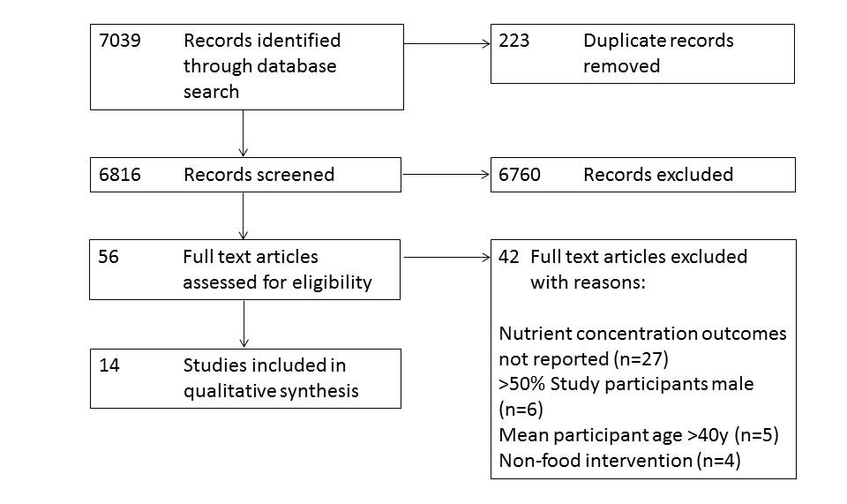
Results 1
Notes:
After removing duplicate records we identified 6816 reports, of which 56 full text articles were assessed for eligibility and 14 were included in the review. 42 records were excluded at this stage

Slide 11
Results 2
13 studies were conducted in high-income countries.
Number of participants ranged from 6-97.
Median (IQR) intervention period was 14 (9, 28) days.
10 studies assessed the effect of the intervention on carotenoids, 9 on vitamin C, 3 on tocopherol, 3 on retinol, 1 on zinc and 1 on folate.
3 studies met all quality assessment criteria.
Beta-carotene and vitamin C status improved in >60% of studies. Findings were inconsistent for other nutrients.
Notes:
13 studies were conducted in high-income countries and generally the number of participants was small ranging from 6-97.
The median intervention period was 2 weeks
Several different micronutrients were studied. Some studies looked at one micronutrient and others at a range of different nutrients
Only 3 of the studies met all quality assessment criteria.
The results showed that beta-carotene and vitamin C status improved in about 2/3 of the studies and the findings were inconsistent for other nutrients.

Slide 12
Results 3
3 types of study design
N studies with significant result
Control
Treatment
3/6
Baseline
Post-intervention
Treatment
4/6
Baseline
Post-intervention
Control
2/2
Treatment
Post-intervention
Notes:
We noted that there were 3 types of study design. The gold standard was considered to be studies with a control group and pre- and post-intervention measurements. 6 of the studies were designed as such. Of these 3 reported statistically significant differences between groups in terms of the change in concentration over the study period. A further six studies made baseline and post-intervention measurements but did not have a control group. 4 of these reported a significant difference between pre and post intervention measurements.
2 studies had a control group but only reported post-intervention measurements. Of these both reported a difference between groups.

Slide 13
Limitations of the review
Small study samples may affect power and external validity.
Interventions and outcome measurements were heterogeneous.
Not possible to estimate an overall effect size.
Circulating levels of nutrients are an indication of micronutrient status. However increasing their levels may not result in improvements in functional outcomes.
Notes:
The study samples sizes were small which may have affected statistical power to detect an effect and may reduce generalisability of the results. Due to the heterogeneity of interventions and outcome measurements among studies, it was not possible to perform a meta-analysis which would have allowed an estimate of the effect size that could be achieved using these food based interventions. It is important to point out that circulating levels of nutrients are an indication of micronutrient status and are frequently used in effectiveness and efficacy studies. However these circulating nutrients are not necessarily optimally utilised by the body and increasing their levels may not result in improvements in functional outcomes.

Slide 14
Conclusion
There is a lack of good quality published data on food based interventions in low and middle income countries.
Increasing intakes of fruit and vegetables may improve the micronutrient status of women of reproductive age but there is insufficient evidence of effectiveness of this approach at the population level.
Interventions should be sustainable and acceptable to the population.
Notes:
Our findings highlight the lack of data, especially from low and middle income countries where such interventions may be of particular benefit for the women themselves and the next generation.
We believe it is important that trials investigating the effect of food based interventions in low and middle income countries are made a research priority. It is also very important that the prescribed changes to the diet are sustainable and acceptable to the community.

Slide 15
Acknowledgements
MRC Lifecourse Epidemiology Unit
University of Southampton
Liz Payne
Karen Drake
Ric Paul
Notes:
I would like to acknowledge the MRC Lifecourse epidemiology unit and the University of Southampton for resources and funding. I would also like to thank my colleagues Liz Payne for advice with the review design, Karen Drake for help with obtaining full text articles and Ric Paul for help with Bibliographic software.

